Slide 1
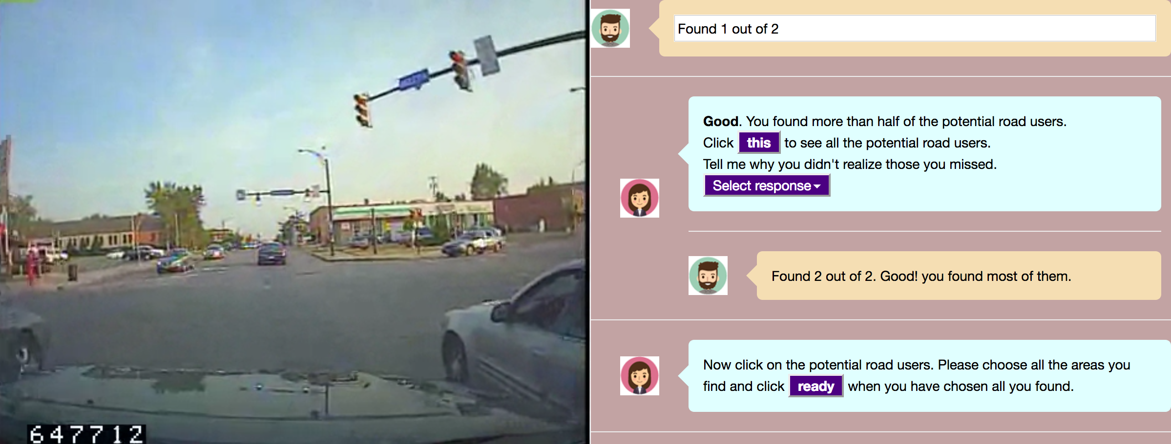
2 out of 3
hazards
2 out of 3
hazards

